Slide 1
Neutron-capture in the wild: finding r-process enhanced metal-poor stars in the Milky Way and beyond!
Vinicius Placco
NSF NOIRLab

Slide 2
Neutron-capture in the wild: finding r-process enhanced metal-poor stars in the Milky Way and beyond!
“Going on a fishing expedition”
Vinicius Placco
NSF NOIRLab

Slide 3
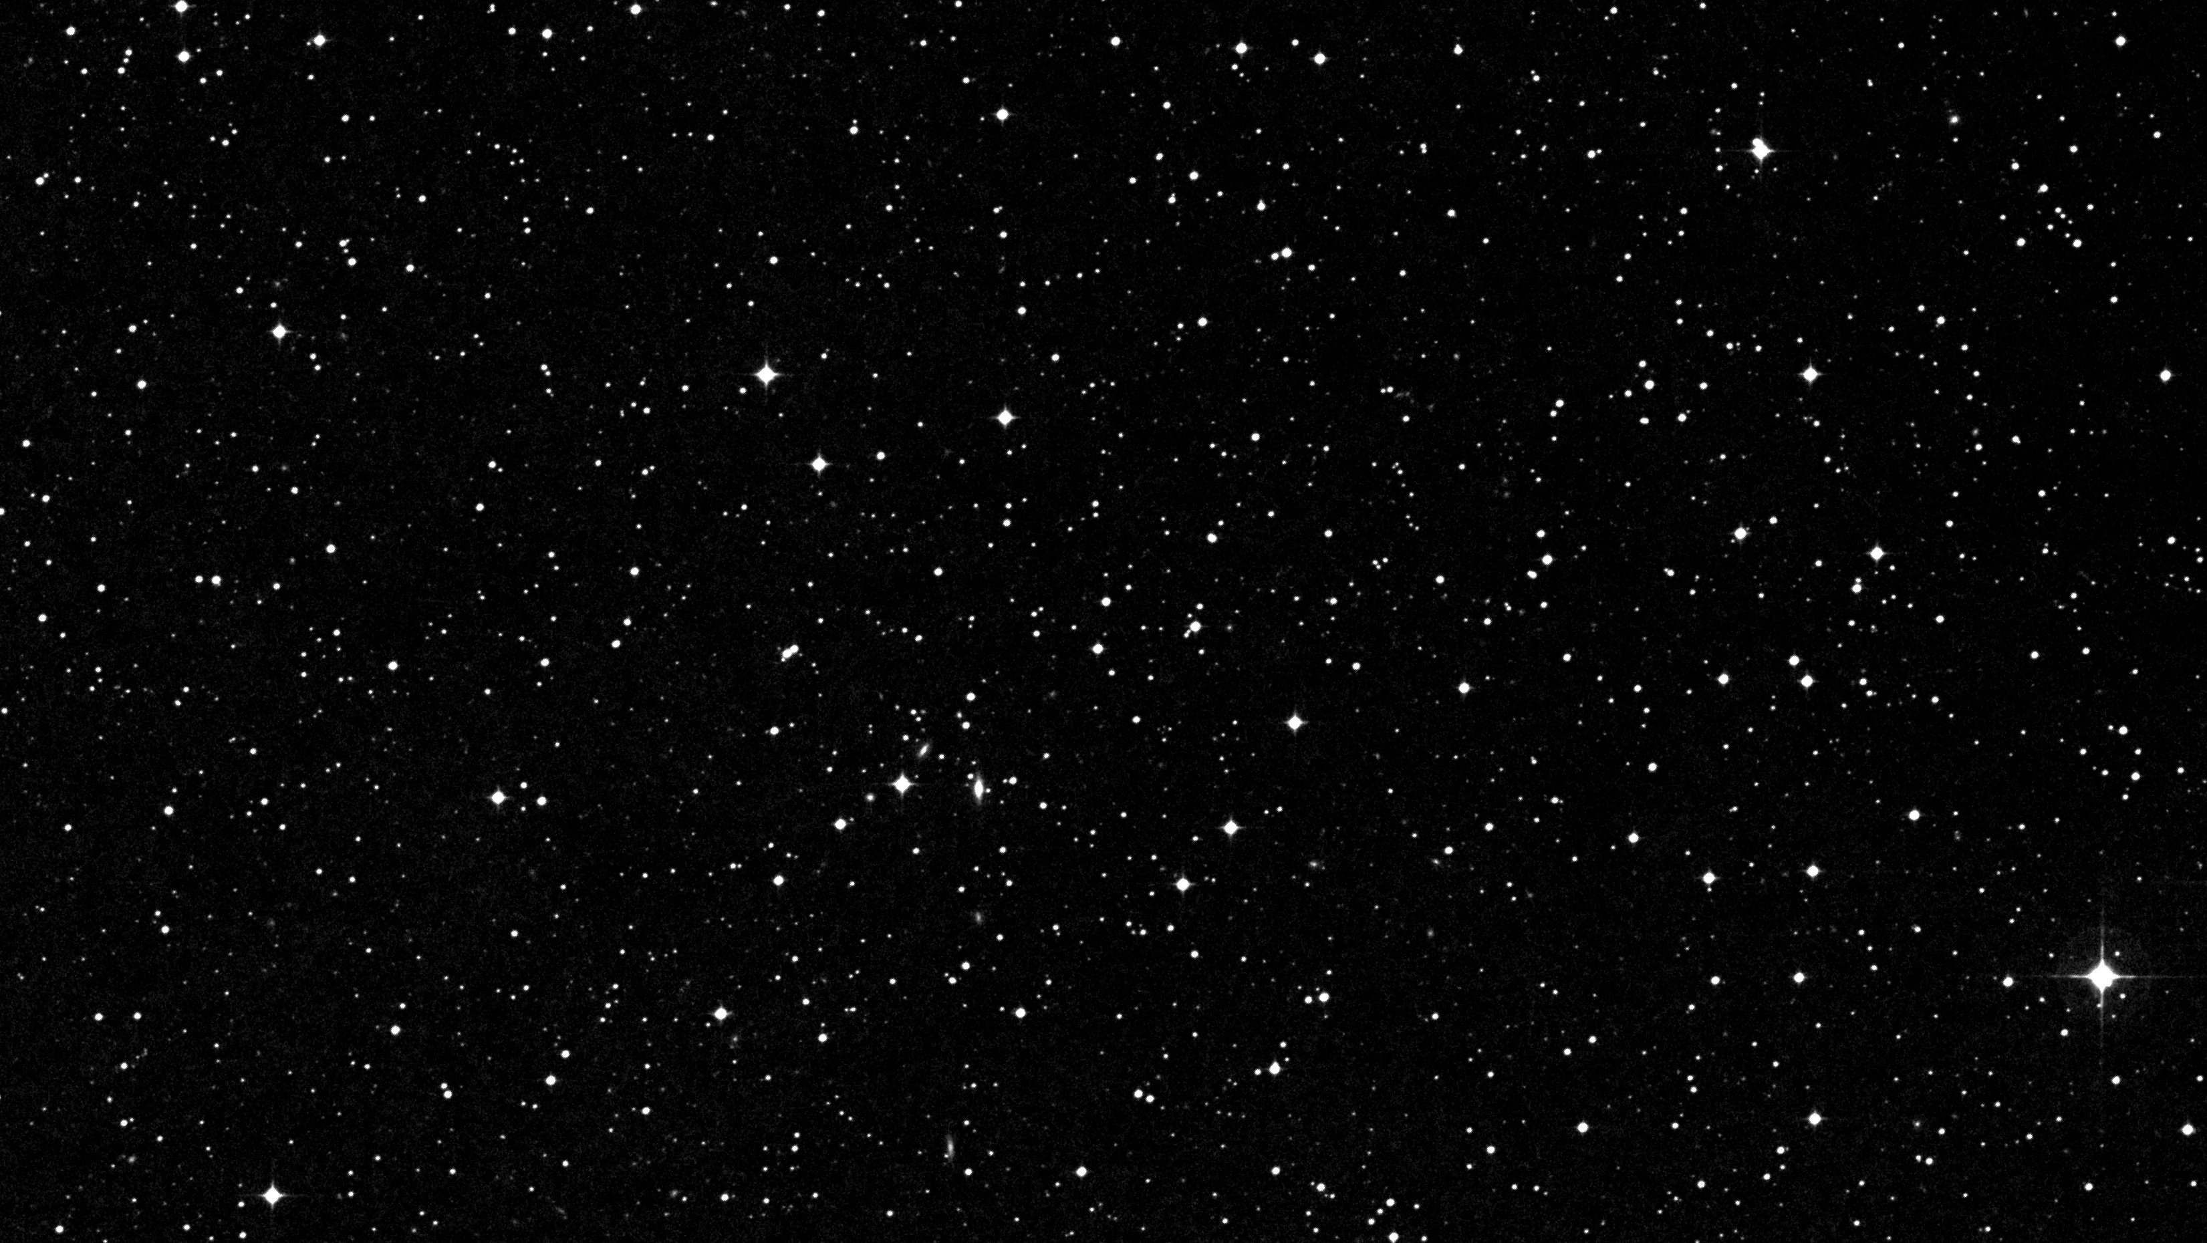
In nature - Stellar evolution
http://chandra.harvard.edu/edu/formal/stellar_ev/
https://noirlab.edu/public/images/NEID-Solarlines-scale-CC
https://noirlab.edu/public/images/NEID-Solarlines-scale-CC

Slide 4
In nature - Stellar evolution
http://chandra.harvard.edu/edu/formal/stellar_ev/
https://noirlab.edu/public/images/NEID-Solarlines-scale-CC
https://noirlab.edu/public/images/NEID-Solarlines-scale-CC

Slide 5
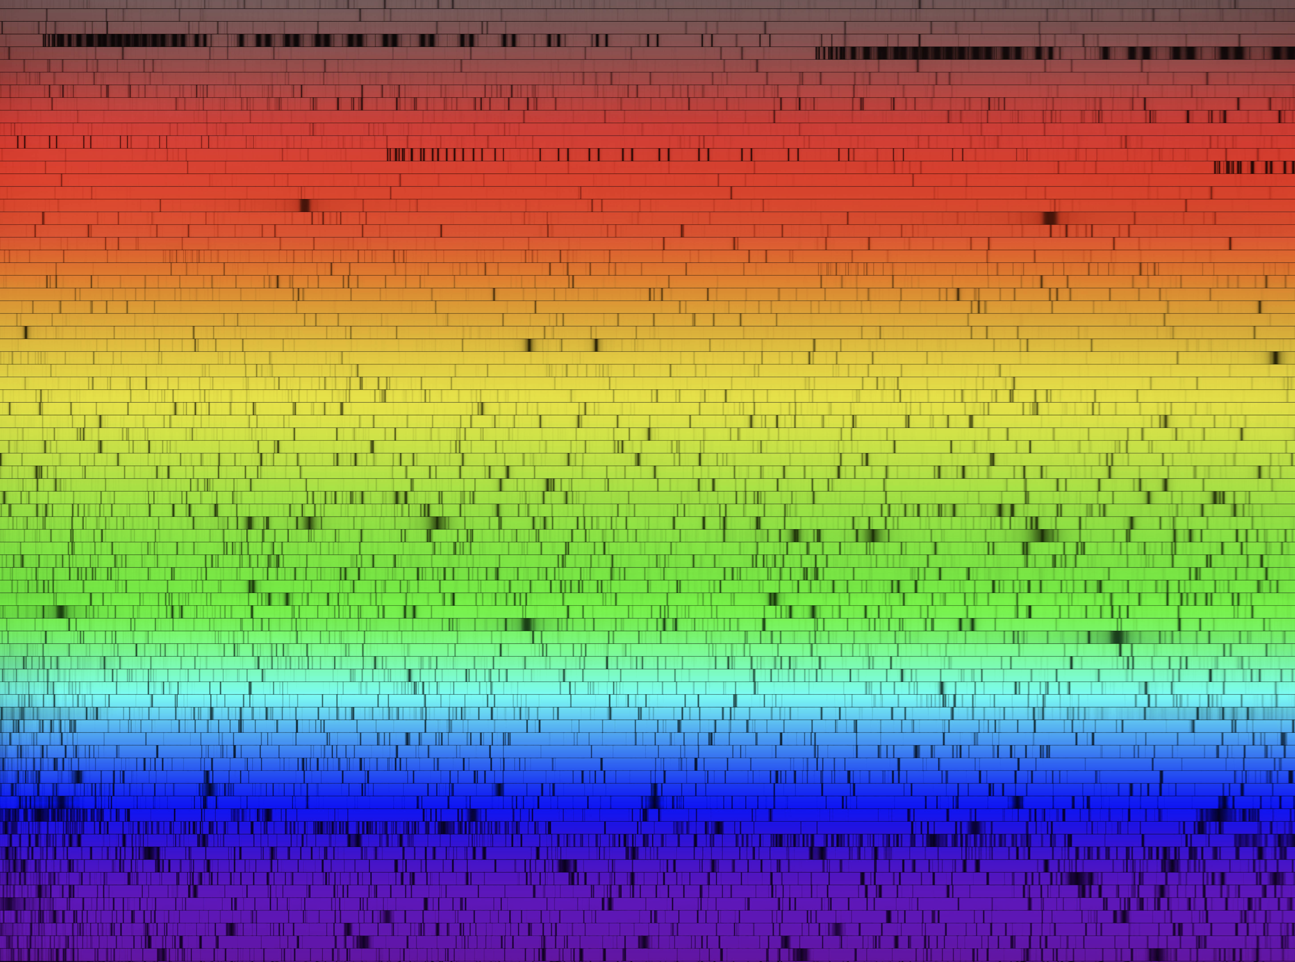
In nature - Stellar evolution
http://chandra.harvard.edu/edu/formal/stellar_ev/
https://noirlab.edu/public/images/NEID-Solarlines-scale-CC
https://noirlab.edu/public/images/NEID-Solarlines-scale-CC

Slide 6
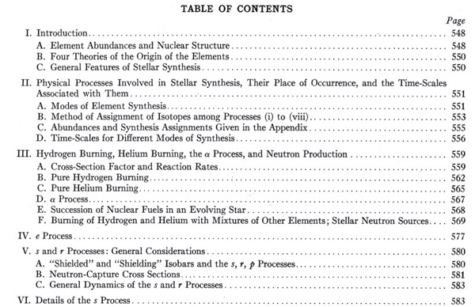
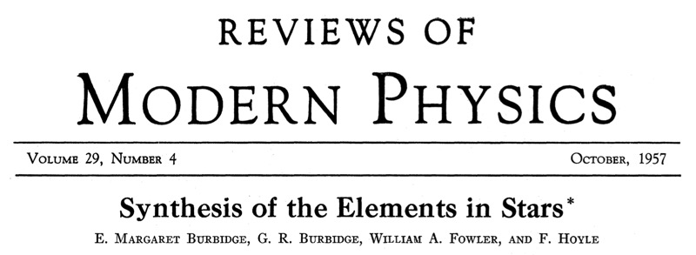
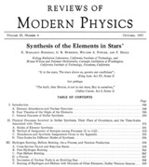
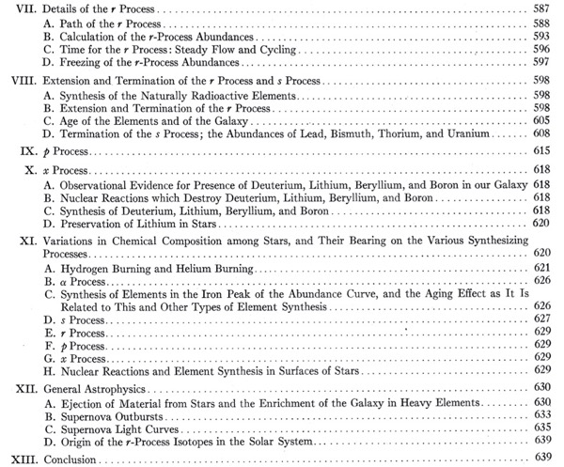
Stellar Archaeology and Nucleosynthesis
Margaret Burbidge (1919 – 2020)
https://en.wikipedia.org/wiki/Margaret_Burbidge
https://skyandtelescope.org/wp-content/uploads/f2_Fowlerbirthday_FH-Library-500px.jpg
https://images.fineartamerica.com/images-medium-large-5/margaret-burbidge-lucinda-douglas-menzies.jpg
https://ui.adsabs.harvard.edu/abs/1957RvMP...29..547B/abstract

Slide 7
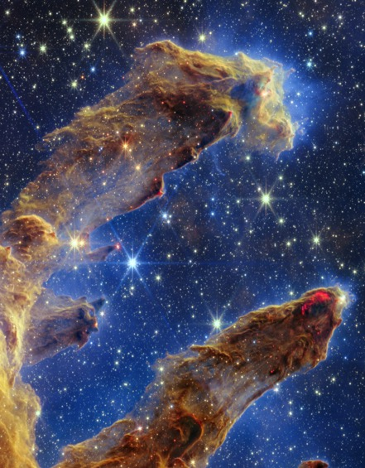
In nature - Stellar evolution
http://chandra.harvard.edu/edu/formal/stellar_ev/
https://webbtelescope.org/contents/media/images/2022/052/01GF423GBQSK6ANC89NTFJW8VM

Slide 8
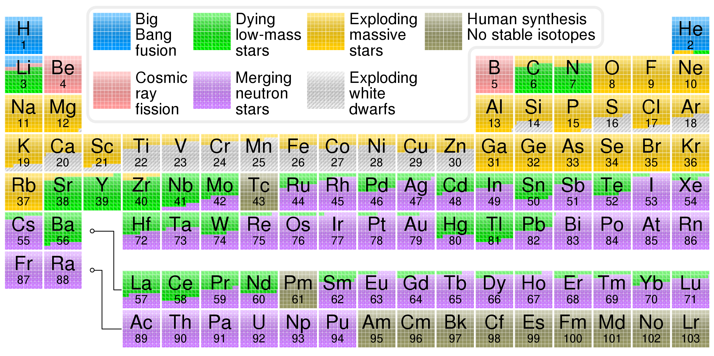
Stellar archaeology and the chemical evolution of the Universe (z = 0)
Credit: Cmglee, CC BY-SA 3.0, https://commons.wikimedia.org/w/index.php?curid=31761437

Slide 9
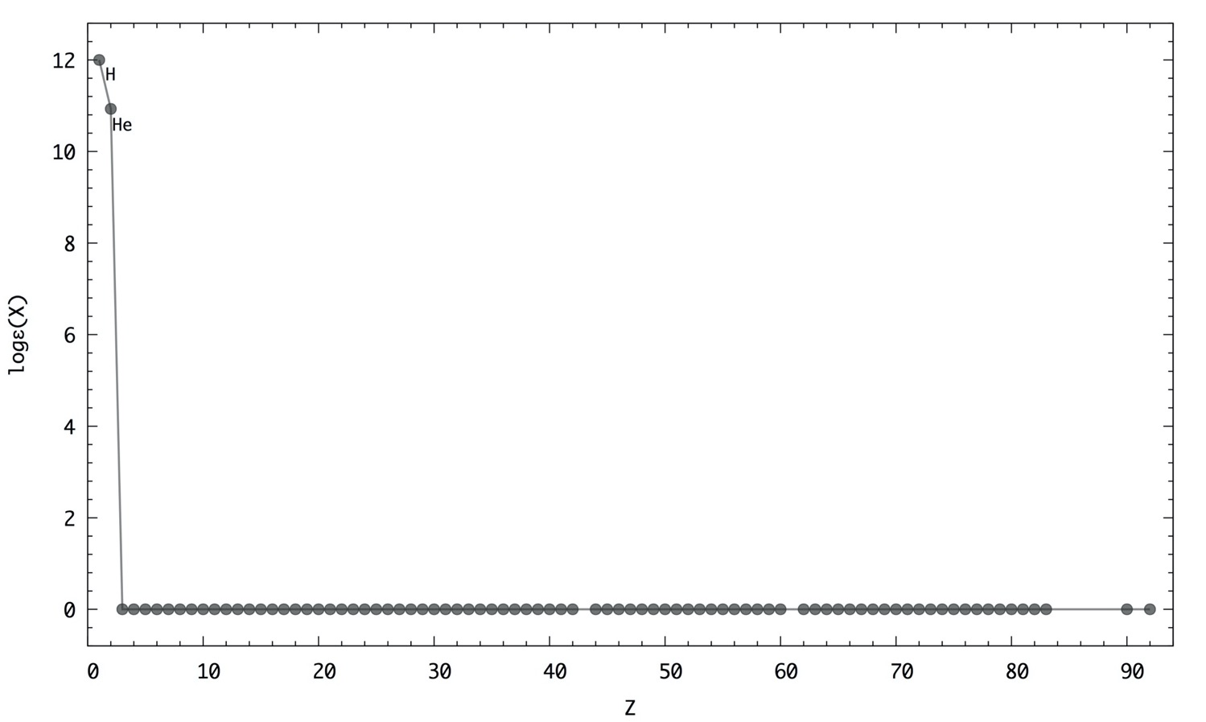
r-process in our backyard

Slide 10
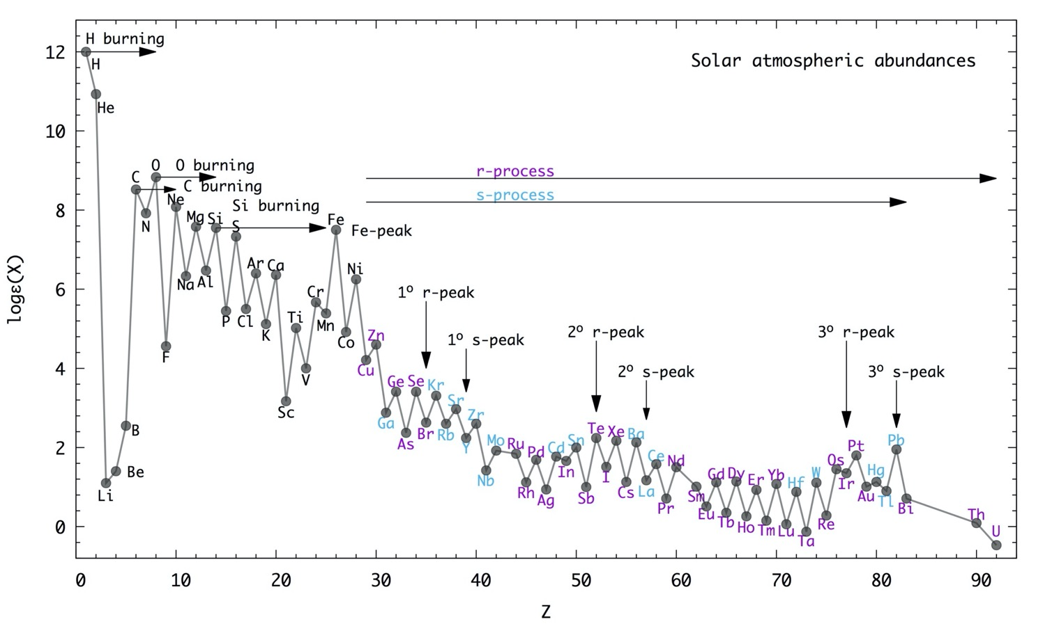
r-process in our backyard

Slide 11
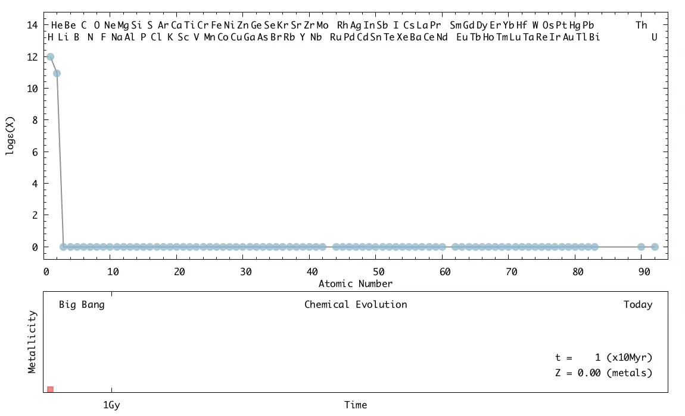
Chemical time machine

Slide 12
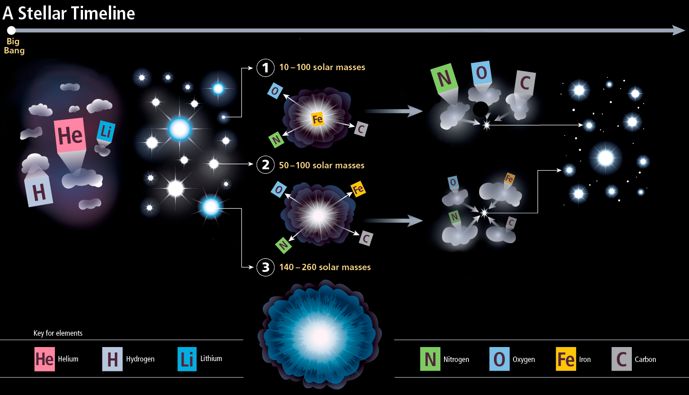
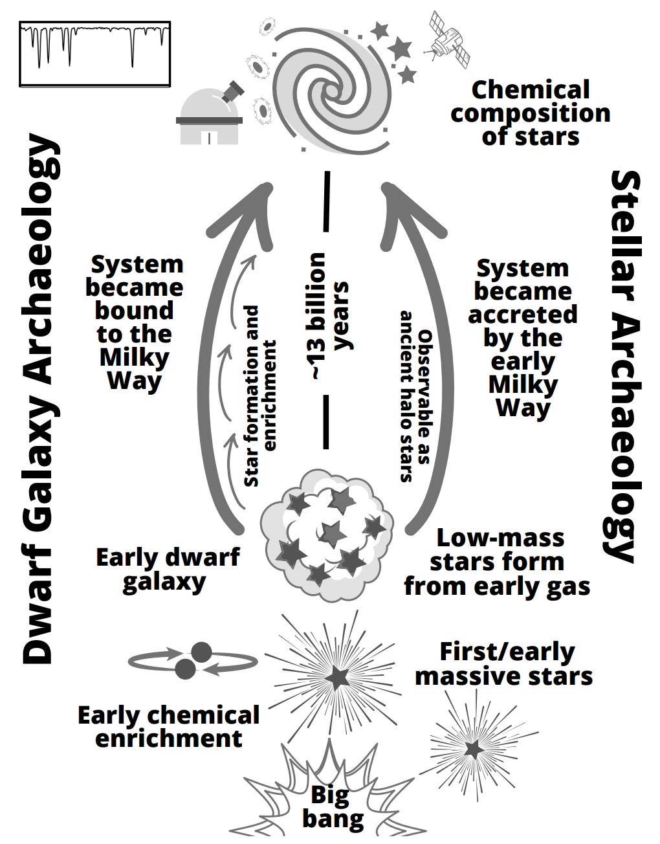
“Near field cosmology” (a.k.a. the next best thing)
Credits: Discover Magazine / Elisa Arizono
Frebel & Ji 2023

Slide 13
r-process enhanced metal-poor stars: when/how were they first formed? how do they look like? where do we find them? how do we find more? the curious case of J1424-2542

Slide 14
r-process enhanced metal-poor stars: when/how were they first formed? how do they look like? where do we find them? how do we find more? the curious case of J1424-2542

Slide 15
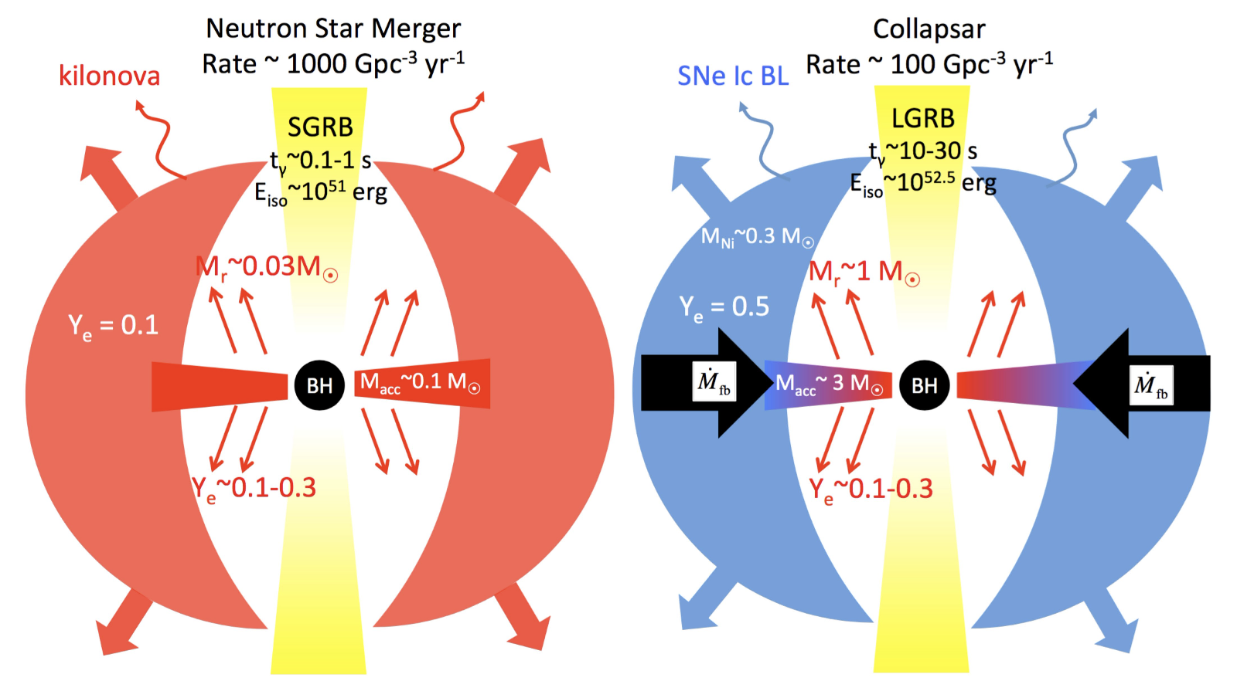
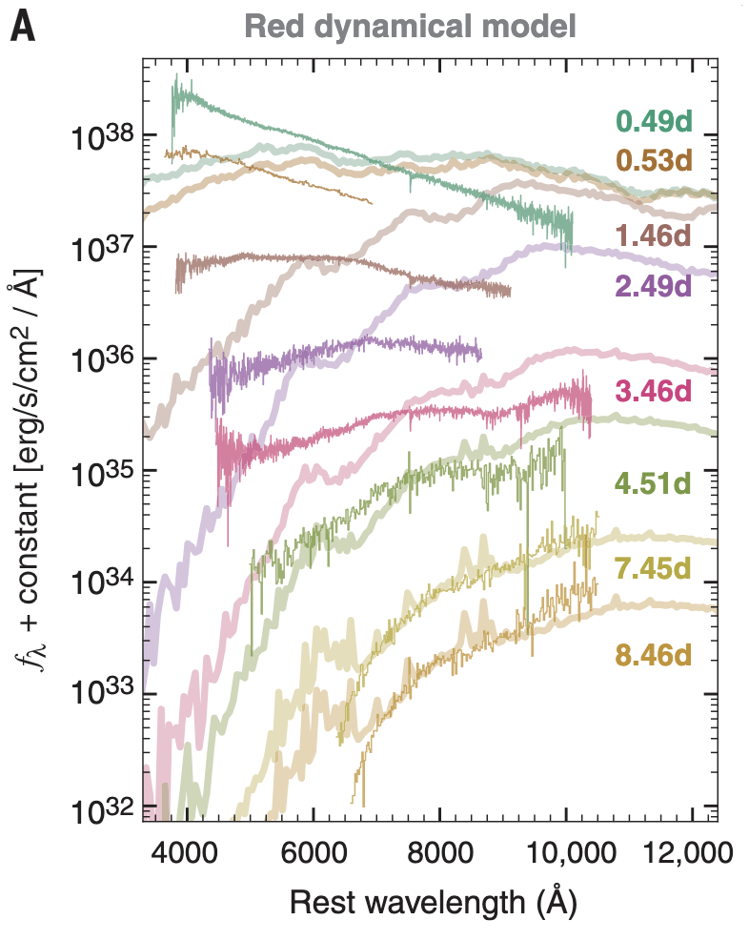
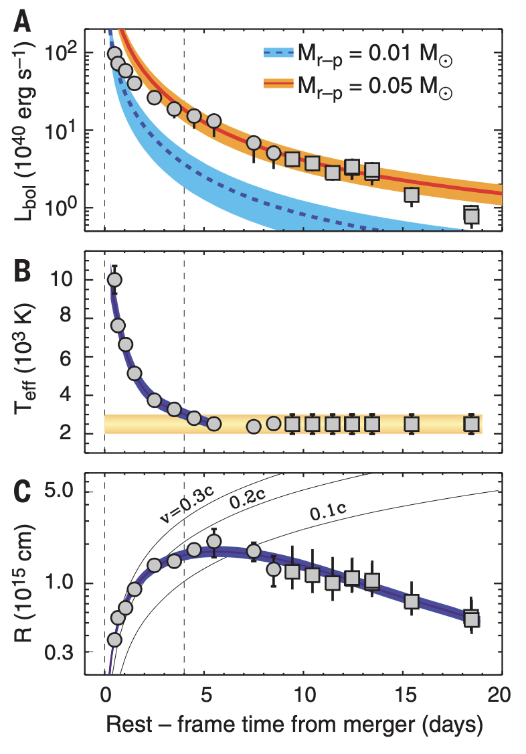
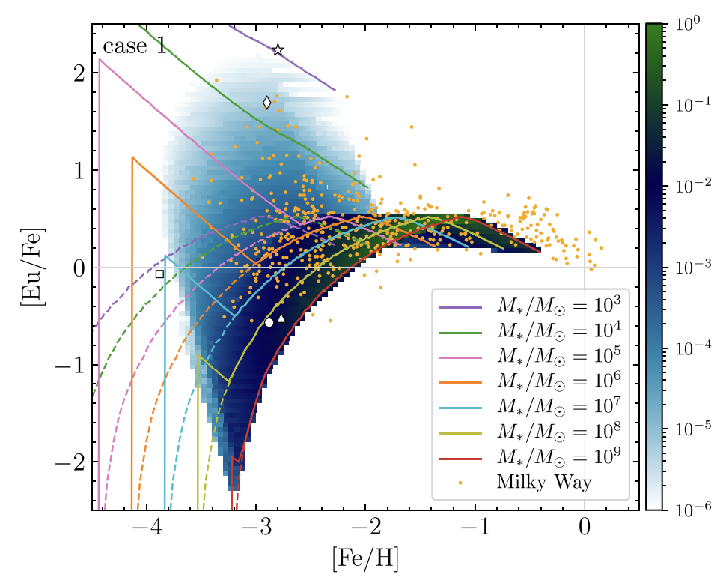
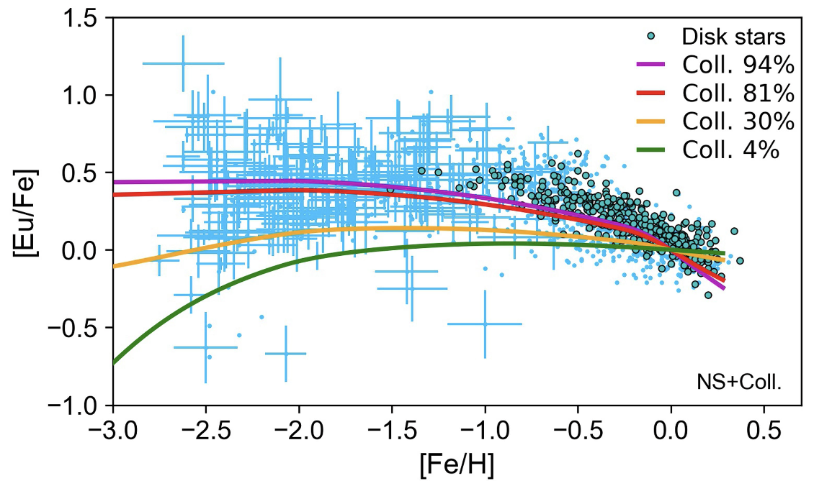
What is the culprit?
Neutron Star Merger: GW170817 → SSS17a
Shappee+2017
Drout+2017
Siegel+2019
Collapsars: supernova-triggering collapse of rapidly rotating massive stars
Wanajo+2021

Slide 16
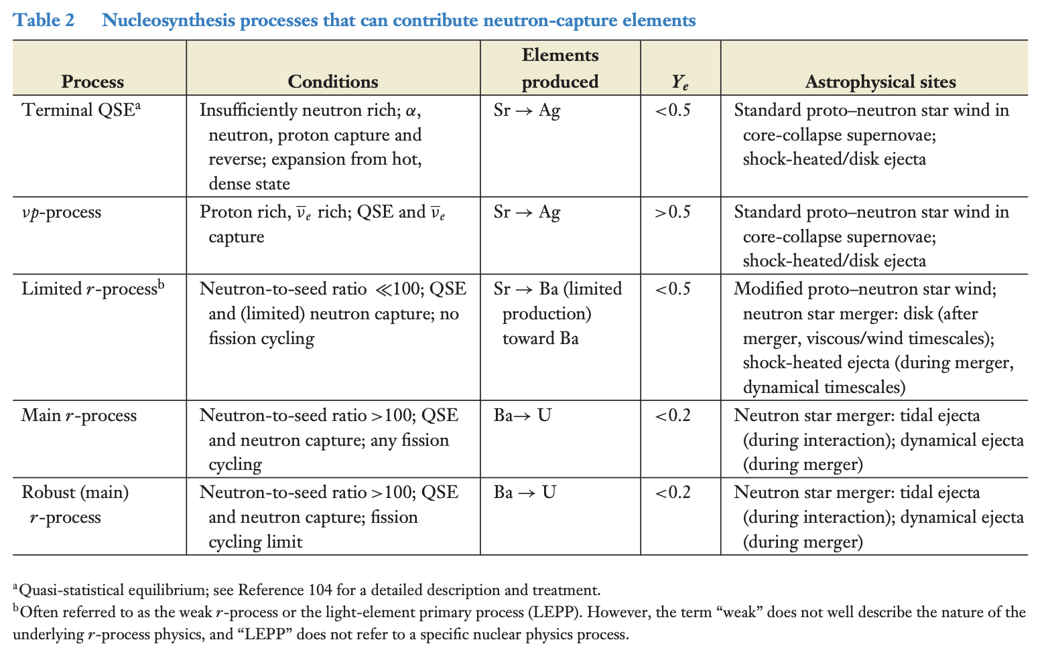
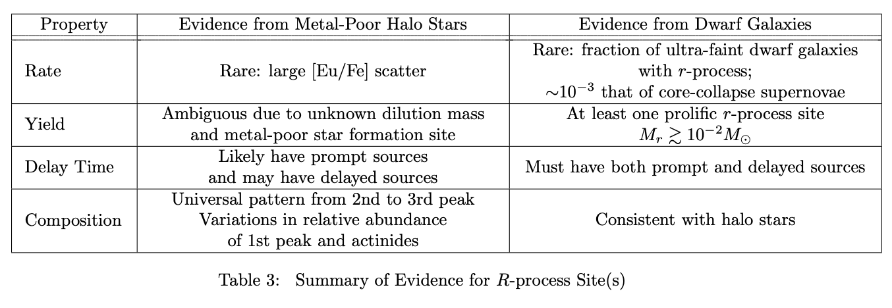
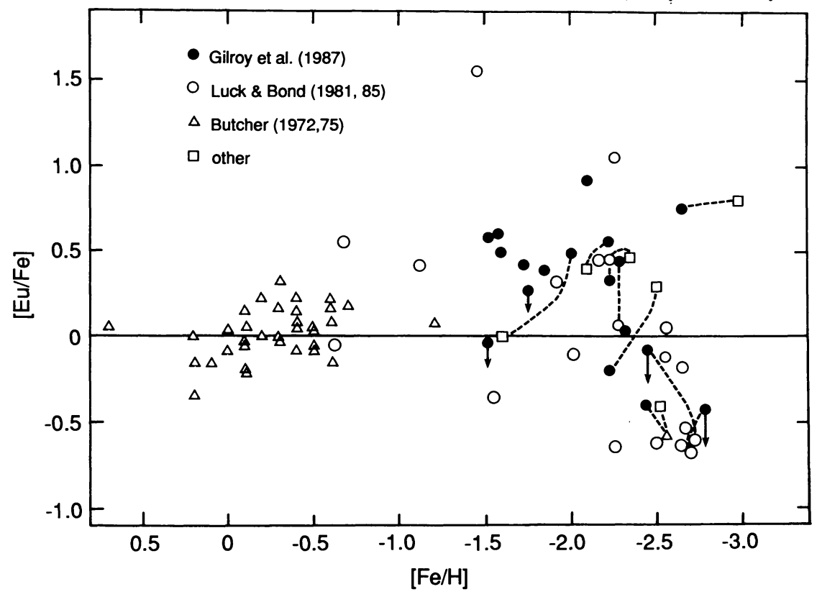
The culprit and the evidence
Frebel & Ji 2023
Frebel 2018
Sneden+1988

Slide 17
r-process enhanced metal-poor stars: when/how were they first formed? how do they look like? where do we find them? how do we find more? the curious case of J1424-2542

Slide 18
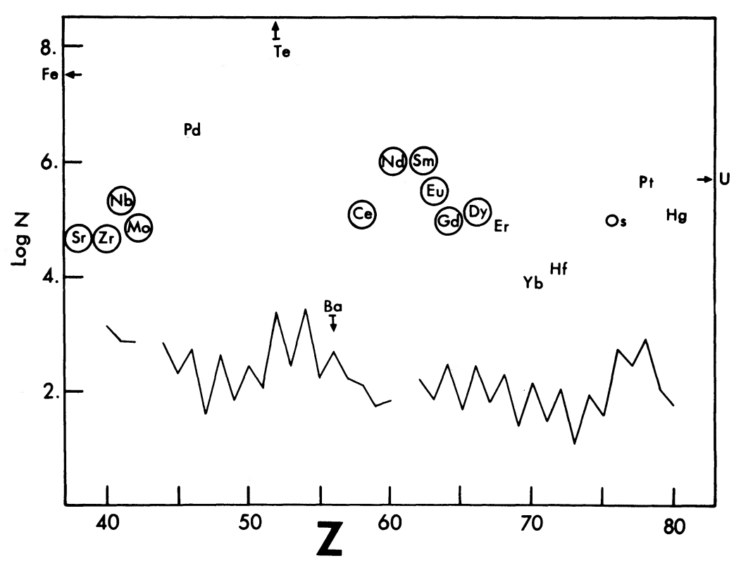
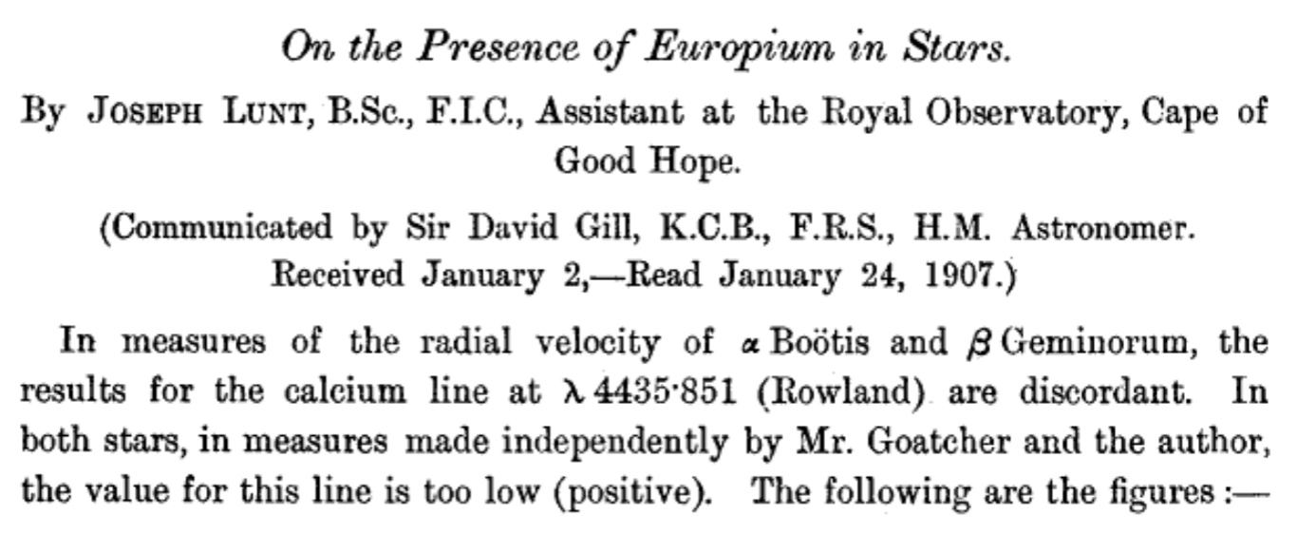
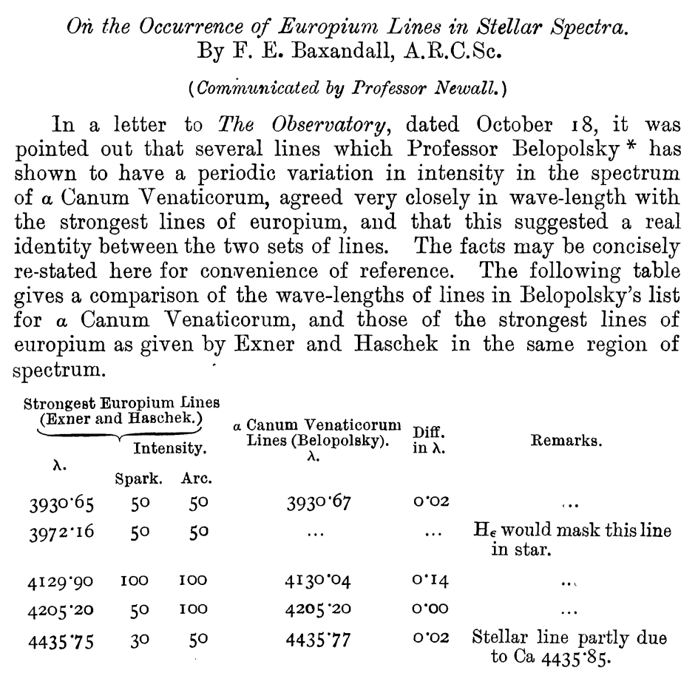
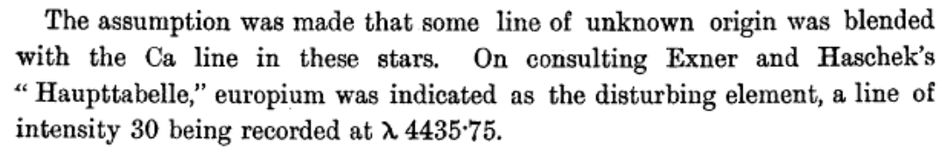
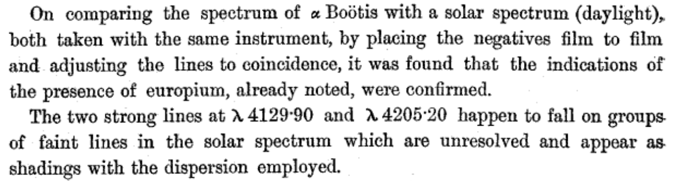
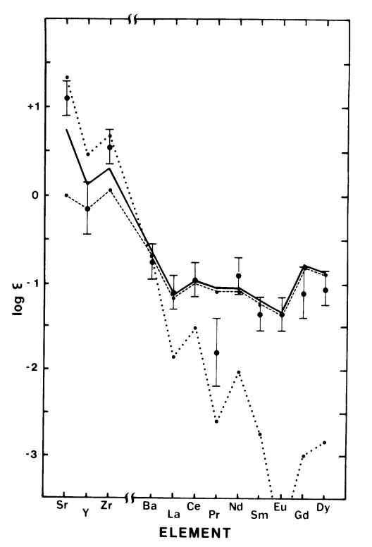
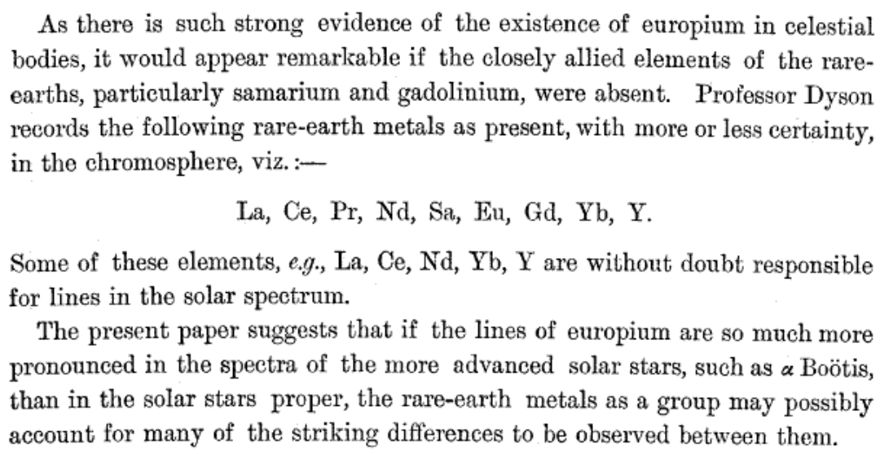
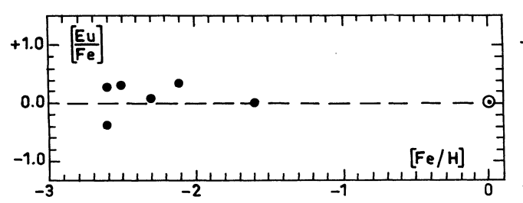
The r-process signature: find europium!
Lunt 1907
Baxandall 1913
Cowley+1973
Spite & Spite 1978
Sneden & Pilachowski 1985

Slide 19
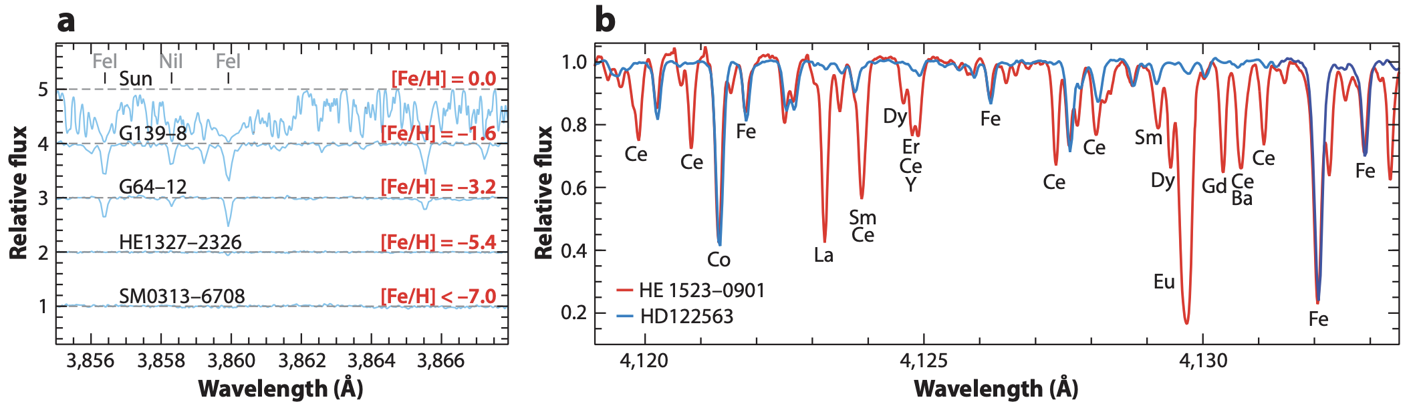
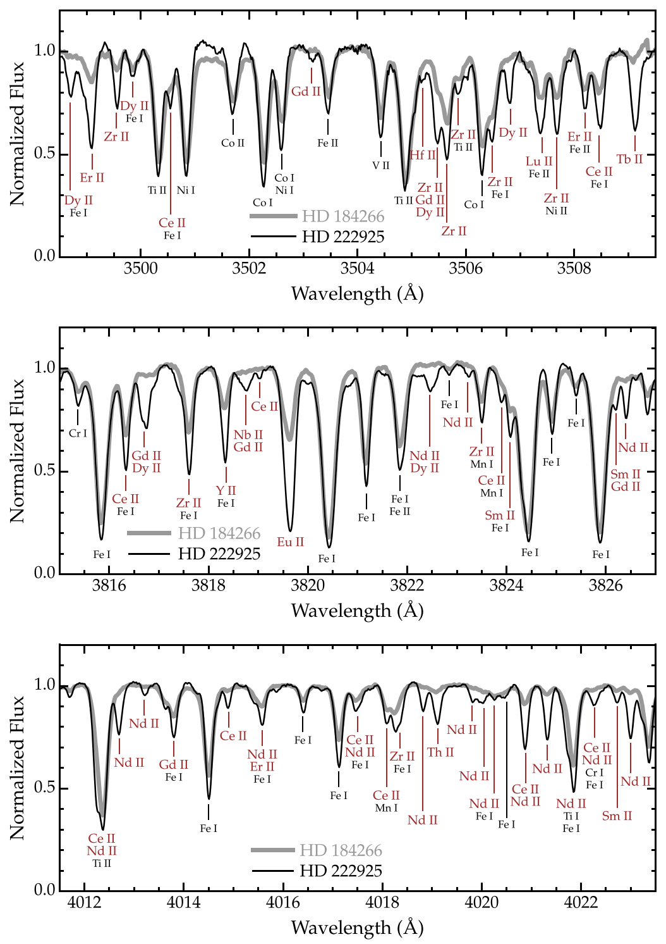
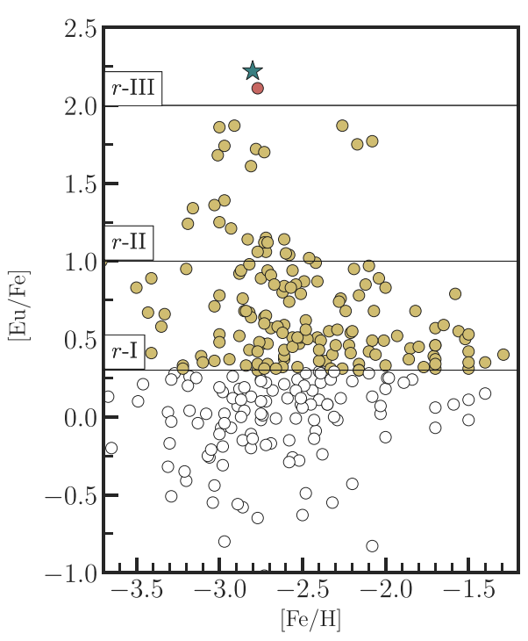

Metal-poor, but with lots of (heavy) metals…
Definition:
Sun: [Fe/H]=0 and [Eu/Fe]=0
Metal-poor: [Fe/H] < -1
r-I:
[Fe/H] < -1
0.3 < [Eu/Fe] < 0.7
[Ba/Eu] < 0.0
r-II:
[Fe/H] < -1
[Eu/Fe] > 0.7 (>1.0)
[Ba/Eu] < 0.0
r-III:
[Fe/H] < -1
[Eu/Fe] > 2.0
[Ba/Eu] < 0.0
Frebel 2018
Roederer+2024
Frebel 2018, Cain+2020, Holmbeck+2020
Roederer+2018
Cain+2020

Slide 20
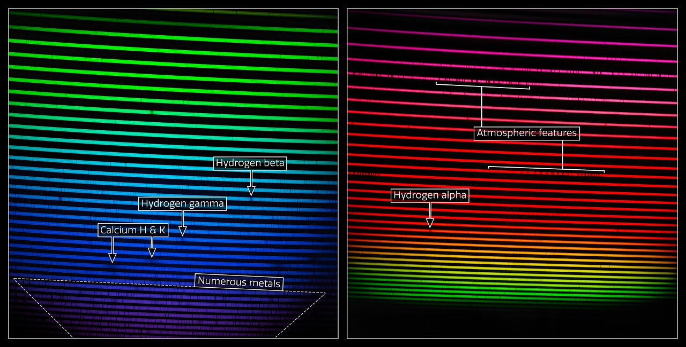
The new standard: HD222925
https://noirlab.edu/public/news/noirlab2217/

Slide 21
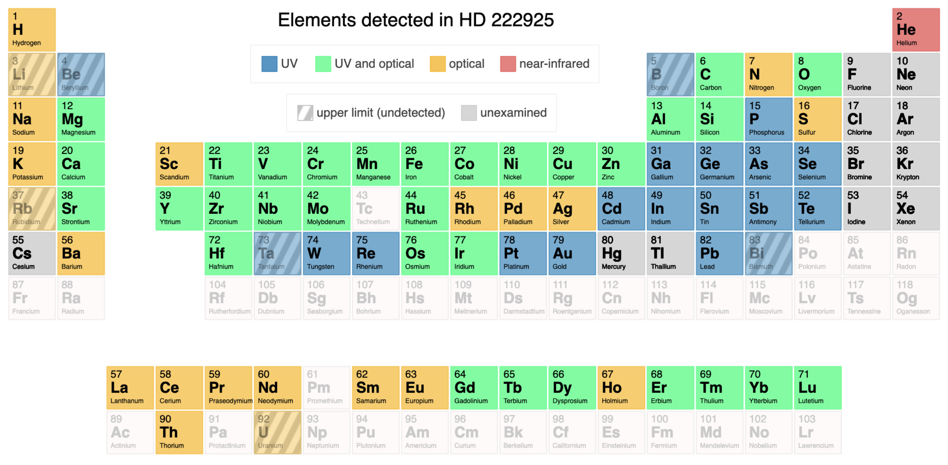
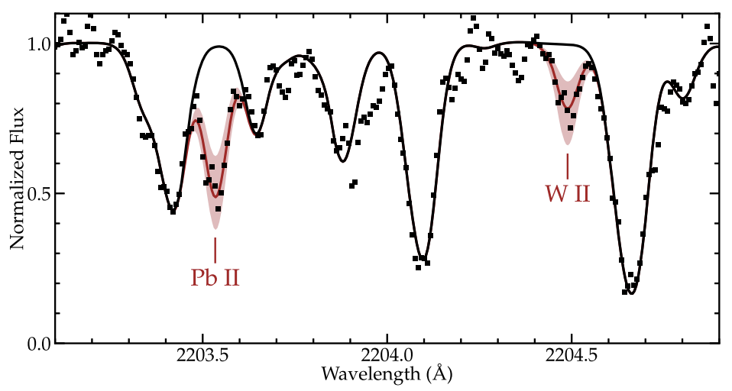
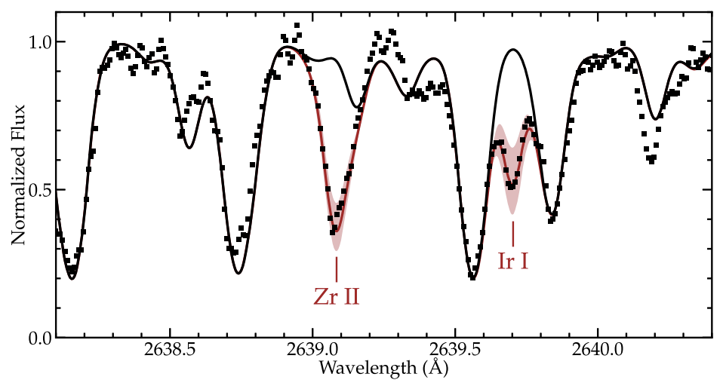
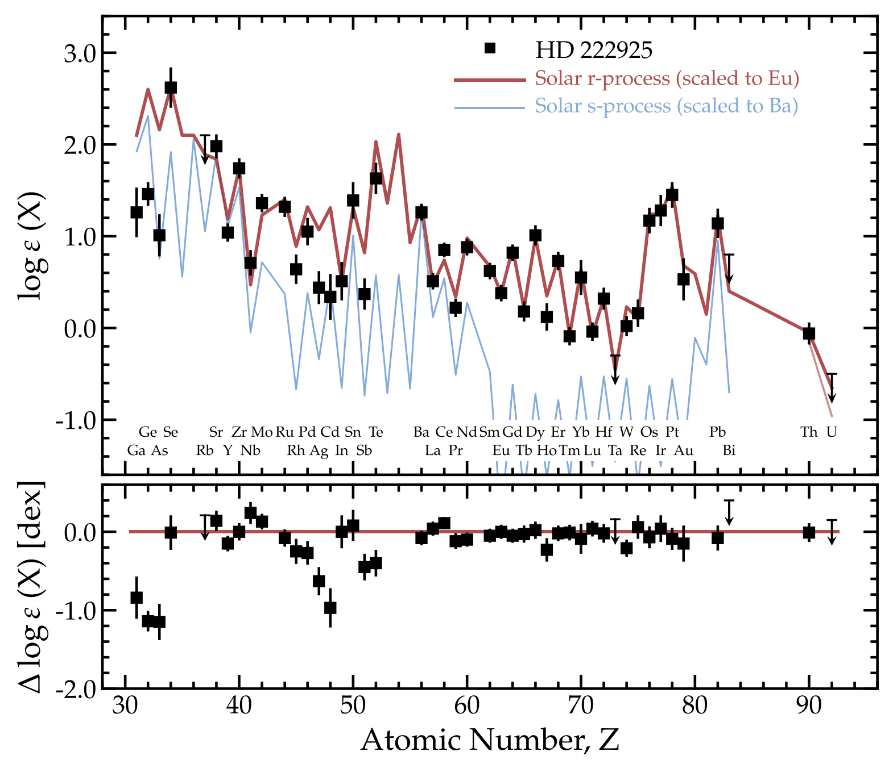
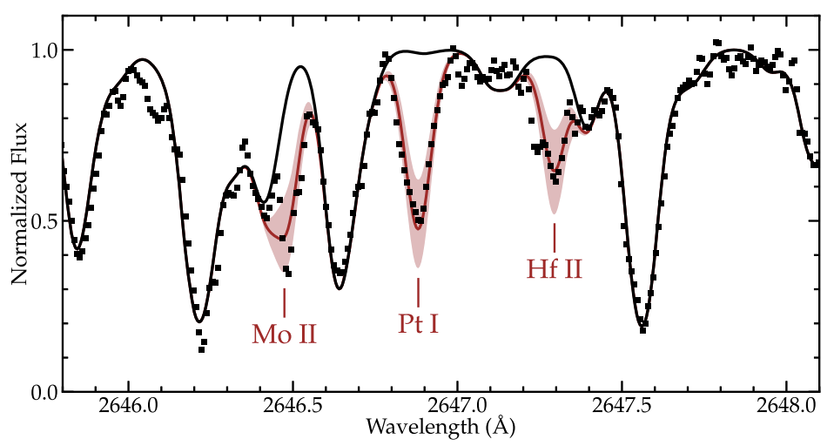
The new standard: HD222925 (63 metals detected)
1,305 lines measured (UV + optical)
Roederer+2018, Roederer+2022

Slide 22
r-process enhanced metal-poor stars: when/how were they first formed? how do they look like? where do we find them? how do we find more? the curious case of J1424-2542

Slide 23
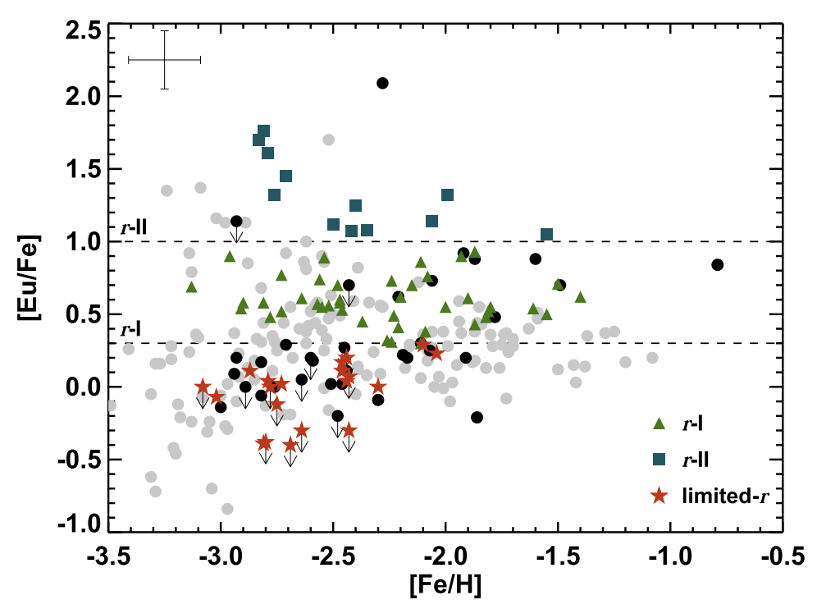
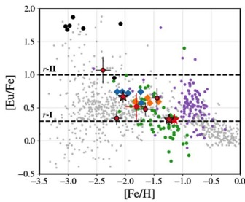
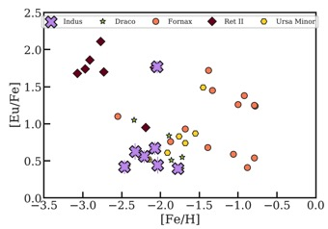
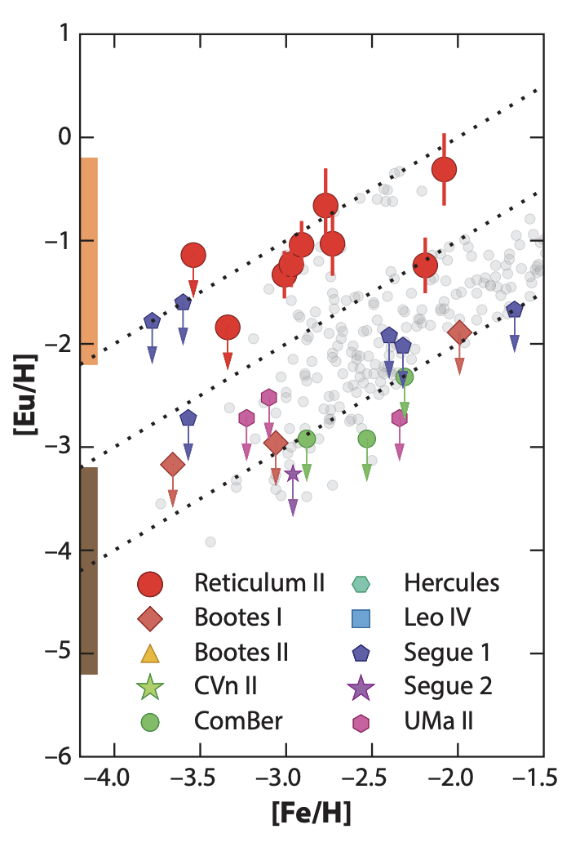
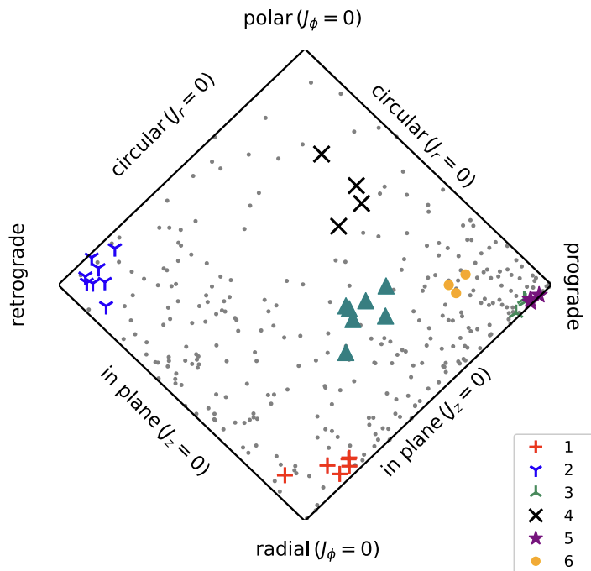
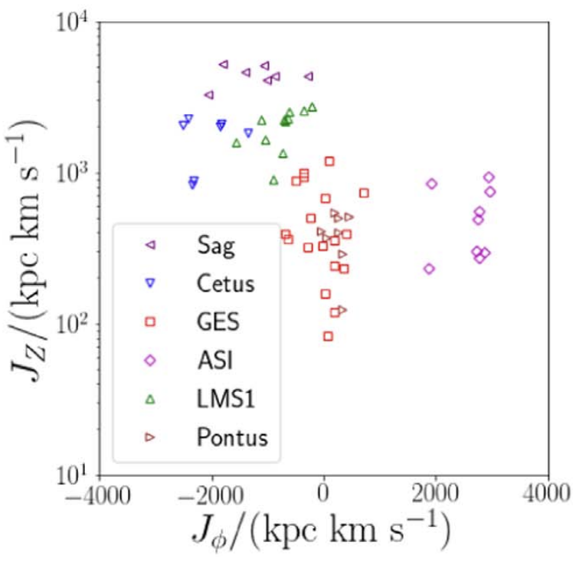
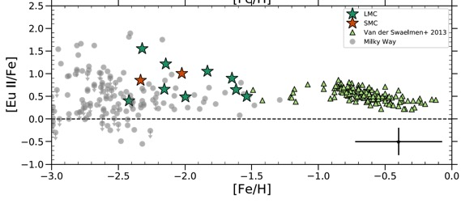
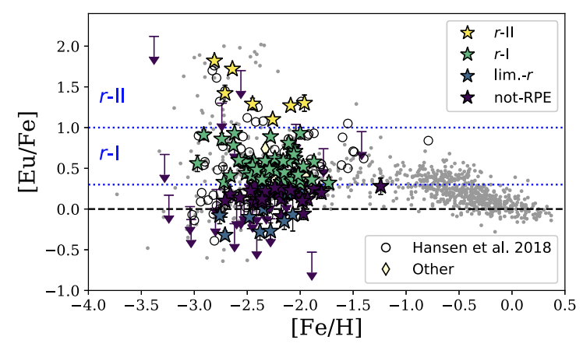
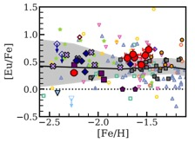
R-process in the MW and beyond* → chemistry and dynamics
MW halo
Helmi
Indus
Reticulum II
Hansen+2021
Hansen+2018
Limberg+2021
LMC/SMC
Ji+2016
Frebel 2018
Reggiani+2021
MW halo
Typhon
Gudin+2021
Hattori+2023
Sakari+2018
*stellar streams, ultra faint dwarf galaxies, classical dwarfs…
Ji+2023

Slide 24

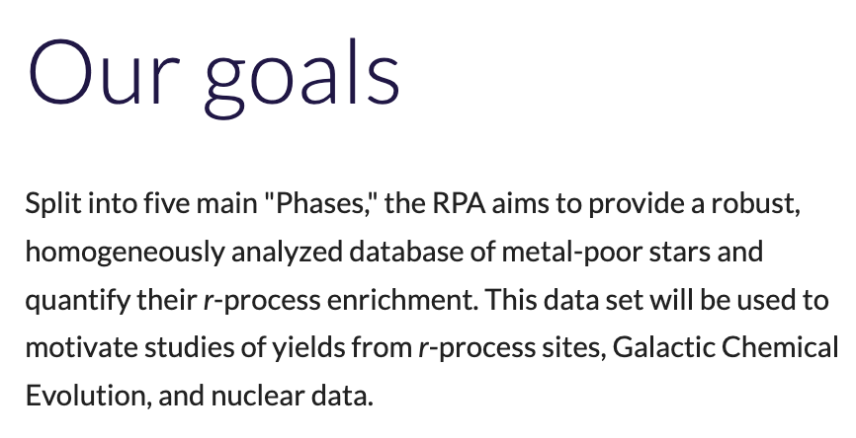
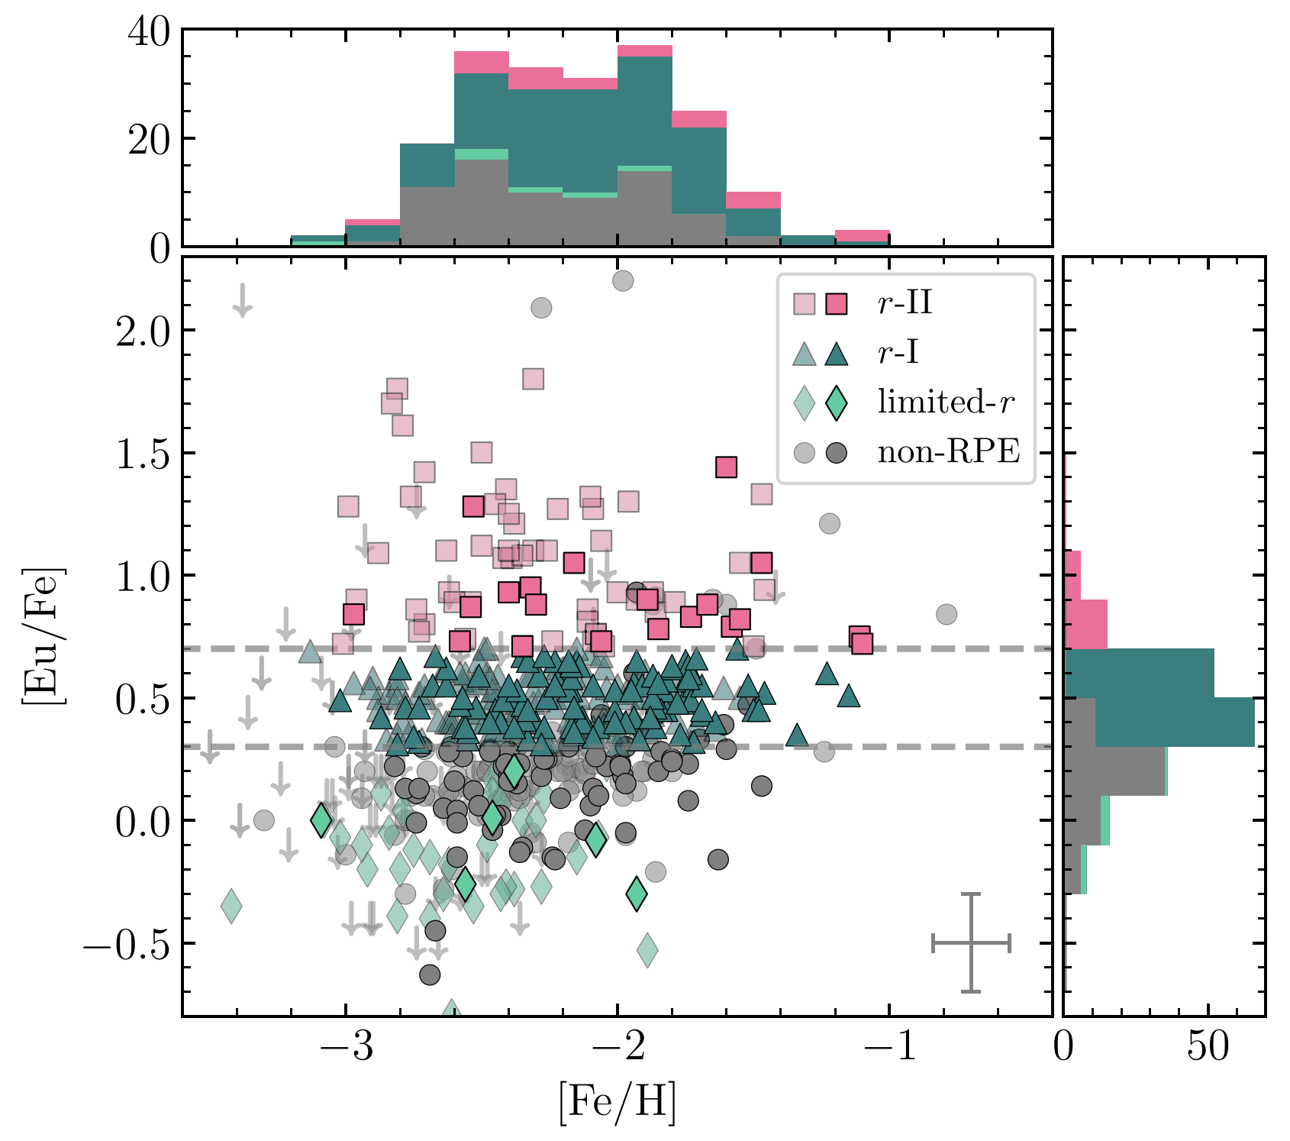
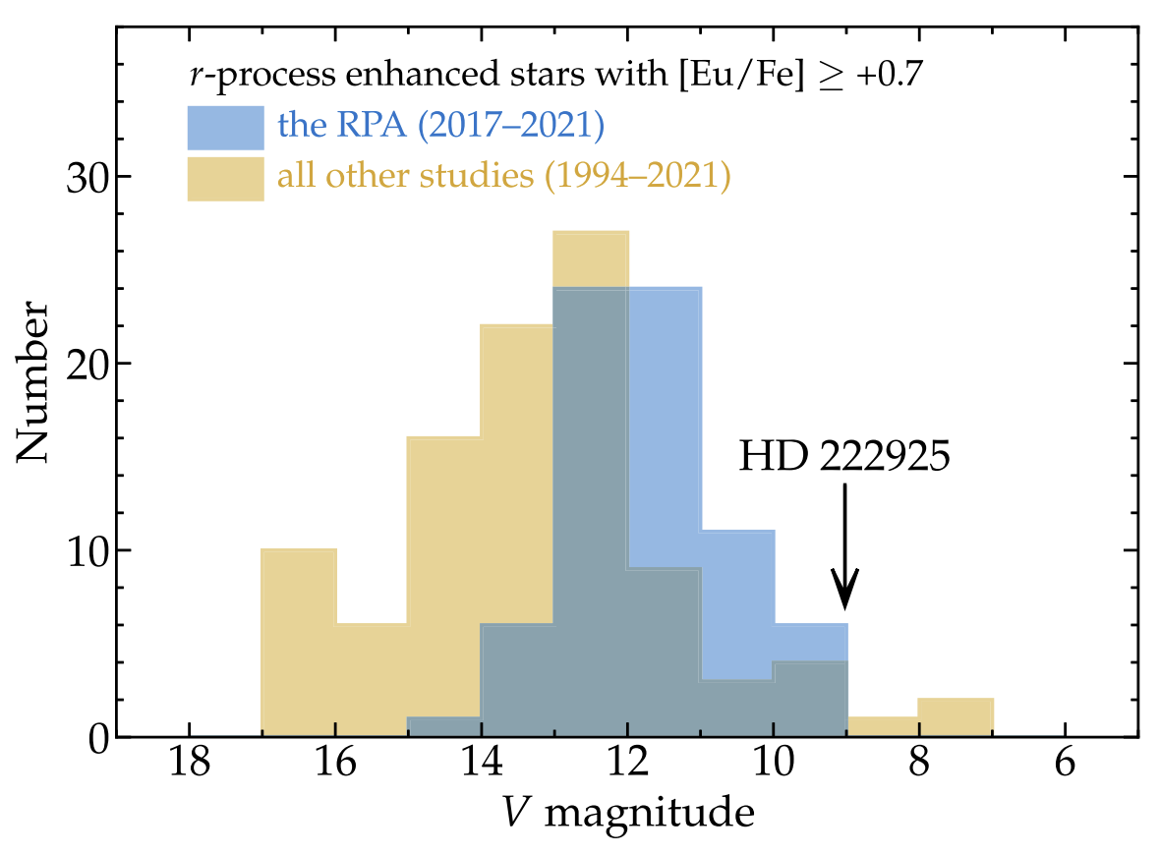
The R-process Alliance
Since 2017:
Five data releases
647 stars published
Homogeneous analysis of over 2,000 stars is coming soon!
Publications:
Placco+2017
Cain+2018
Gull+2018
Hansen+2018
Holmbeck+2018
Placco+2018
Roederer+2018
Sakari+2018a
Sakari+2018b
Placco+2019
Sakari+2019
Cain+2020
Ezzeddine+2020
Holmbeck+2020
Placco+2020
Gudin+2021
Roederer+2022a
Roederer+2022b
Shank+2023
Bandyopadhyay+2024
Roederer+2024
Shah+2024
Xylakis+2024
Hansen+2025
Hirai+2025
72
100
Roederer+2022
Holmbeck+2020
https://sites.google.com/view/rprocessalliance/

Slide 25
r-process enhanced metal-poor stars: when/how were they first formed? how do they look like? where do we find them? how do we find more? the curious case of J1424-2542

Slide 26

How do we (effectively) choose targets?

Slide 27

An image is worth a thousand words
https://space-facts.com/galaxies/andromeda/
https://en.wikipedia.org/wiki/Andromeda_Galaxy

Slide 28



A spectrum is worth n images, where

Slide 29

The effect of resolution - what is the ideal n?

Slide 30




From R~30 to R~30,000 (finding the ideal n to determine chemical abundances)
From hydrogen to uranium
C, Ca, Mg, Fe*, Si*, Ni*, Sr*, Ba*
High-resolution (R ~ 30,000)
Moderate-resolution (R ~ 3,000)
C, Mg, Ca ([Fe/H] proxy)…
C, Mg, Ca ([Fe/H] proxy)…
Low-resolution (R ~ 300)
Narrow-band photometry (R ~ 30)

Slide 31
How about observing “everything”?
Placco+2022

Slide 32

J-PLUS (Javalambre Photometric Local Universe Survey) S-PLUS (Southern Photometric Local Universe Survey)
T80 N/S: 80cm
FOV: 2 deg²
Footprint: 17,000 deg² (N/S)
Cenarro+2019
Mendes de Oliveira+2019

Slide 33
S-PLUS/J-PLUS (Filter system)

Slide 34
S-PLUS/J-PLUS (Filter system)

Slide 35



How do changes in [Fe/H] affect fluxes?
Placco+2022

Slide 36




Artificial Neural Networks
Determine T_{eff}, [Fe/H], and [C/Fe]
Whitten, Placco, JPLUS Collab+2019
Whitten, Placco, SPLUS Collab+2021

Slide 37


Chemodynamical Properties and Ages
Find r-process → Select old, low-mass,
low-[Fe/H], low-carbon, giant stars
Almeida-Fernandes, Placco+2023

Slide 38
r-process enhanced metal-poor stars: when/how were they first formed? how do they look like? where do we find them? how do we find more? the curious case of J1424-2542

Slide 39


The power in numbers
S-PLUS (0.8m) → ~20 million objects
(photometry - narrow+broad band)
Gemini South (8.0m) → 138 objects
(medium-resolution spectroscopy)
(GMOS - Poor weather program)
Gemini South (8.0m) → 1 object
(high-resolution spectroscopy)
(GHOST – Science Verification)
Placco+2022
Almeida-Fernandes+2023
Almeida-Fernandes+2022
Placco+2023

Slide 40


SPLUS J1424-2542 (g=14.4) – as “boring” as a star can be…
Placco+2023

Slide 41

SPLUS J1424-2542 → What GHOST revealed
Stellar parameters:
T_{eff}: 4762
logg: 1.58
[Fe/H]: -3.39
Chemical abundances:
36 elements (C to Th)
308 absorption features
Placco+2023

Slide 42


SPLUS J1424-2542 → Getting chemical abundances
Placco+2023

Slide 43

SPLUS J1424-2542 → Getting chemical abundances
Placco+2023

Slide 44

SPLUS J1424-2542 → light-element abundances vs. Pop III SN yields
Placco+2023

Slide 45

SPLUS J1424-2542 → heavy-element abundances vs. Solar System
Placco+2023

Slide 46





SPLUS J1424-2542 → Actinide-boost!
Placco+2023
Lin+2025
Honda+2004
Wanajo+2024

Slide 47

SPLUS J1424-2542 → heavy-element abundances vs. neutron star merger
Placco+2023

Slide 48



SPLUS J1424-2542 → age, mass, and kinematics
Placco+2023

Slide 49

What now?
R-Process Enhanced Stars
- Galactic chemical evolution
- Address frequencies of NS+NS mergers and Collapsars
J1424-2542
Old, low-mass, halo star
Help constrain Actinide-boost phenomena
Two progenitors?
SN explosion of a 13.4 M_{o} Pop. III star +
Neutron star merger (1.66 M_{o} + 1.27 M_{o})
Moving forward
Statistics, statistics, statistics
Homogeneous samples and analyses
Modelers: talk to your observer friends!
Observers: talk to your modeler friends!
credit: Babak Tafreshi /NOIRLab/AURA/NSF

